Slide 1
Job Aid 3: Objectives ⁴⁻⁸⁵
Anything that can be counted can be accounted for
Objectives - These are the measurable goals that truly indicate success or failure as an organization.
Categories of Objectives
Perpetual organizational objectives
Established at the laboratory management level
Stem from quality policy; typically set-up when the QMS was first developed; serve as the foundational measures of the laboratory’s ability to fulfill customer-specified requirements
Serve as long-term objectives that frequently involve some connection with on-time delivery or zero defects. A zero defect acceptable threshold signifies that the risk incurred from the severity component alone is in itself an unacceptable level of risk.
Excerpt from the Quality Policy
The Cape Clinic Hospital Laboratory is committed to enhancing patient safety through the provision of consistently high-quality laboratory services which provide accurate, reliable and timely results.
Evidence the Quality Policy is being supported.
Quality Policy Area | Quality Objective (QO) | Path of Workflow Phase (PoW) | Metric (measurable component of the QO) | Acceptable Threshold | Current Standing
Patient Safety | Completely and accurately identify patients | Pre-exam PoW | Rejection Rate | < 100/month | Meets threshold
 |  |  | Patient ID Events | Zero- no occurrence | Meets threshold
 |  |  | Test Order Accuracy | < 5/month | Exceeds threshold
 | Completely and accurately identify specimens | Pre-exam PoW | Requisition Completion | < 10/month unacceptable | Room For Improvement
 |  |  | Specimen Identification Events | Zero- no occurrence | Meets threshold
 |  |  | Rejection Rates | < 100/month | Meets threshold
 | Perform satisfactorily on all PT/EQA exams | Exam | PT Review /Failure and Trending | Zero- no occurrence | Exceeds threshold
 | Perform all necessary QC measures | Exam | QC Review and Trending | And so forth | And so forth
 |  |  | Equipment Maintenance
 |  |  | Calibration Events
 |  |  | Analytical Error Events
 | Communicate all critical results appropriately and in a timely manner | Post-exam | Critical Reporting TAT
.
Translate the quality policy into objectives and then into metrics. Consider the objectives as the things the laboratory needs to do to achieve each element of the quality policy and the metrics are the measures that will tell the laboratory whether the organization has been successful or not.
Objectives should be measurable and periodically monitored to demonstrate continual improvement in the interest of patient care.
Measurable objectives help communicate organizational direction and drive improvements. THESE are what employees really need to understand from the Quality Policy; the objectives that apply to them. They must understand that management is targeting key areas and will hold the competent employee responsible for performing the task correctly as reflected in the measurements collected and analyzed.

Slide 2
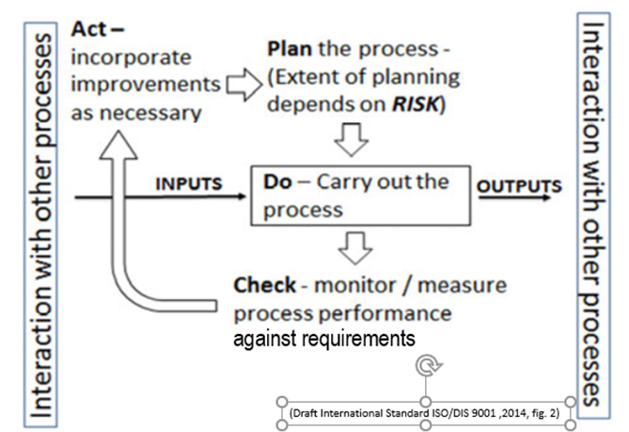
Some quality objectives should change annually after achievement.
Categories of Objectives (continued)
Specific process objectives
Established in response to a particular situation or initiative.
Target a specific goal. Once the target is achieved and proved sustainable, it is integrated into the SOPs for that process and becomes a quality requirement for compliance and confirmed during an internal audit (CHECK).
This type of objective is not expected to remain an objective forever as the perpetual objectives do. Instead, these specific objectives transition to criteria used to monitor effectiveness.
Study -
PLAN | Laboratory creates a process for reporting critical values. The criteria proposed to monitor effectiveness is the notification time.
DO | The process is implemented
STUDY | A QI shows the median notification time has been 15 minutes (i.e. ½ were < 15 minutes and ½ > 15 minutes) for the last 3 months. Laboratory management establishes an objective to improve the notification time so that 95% of the values are reported within 15 minutes.
ACT | Action is taken to achieve objectives, and the process is improved.
After achieving sustainability, the laboratory incorporates the notification criteria of within 15 minutes. The laboratory director approves the revised procedure stating a maximum of a 15 minute notification time. The revised procedure is implemented. The internal audit CHECKS conformance. The objective does not go away, it just transitions into a quality requirement.
.
Think of the measurable objective as the measurand of the process.

Slide 3
A QI is typically a measurement associated with a process performance objective.
Image adapted from Appendix A, (Phillips, 2009)
QMS 1: Management Responsibility
QMS 2: Resource Management
QMS 3: Path of Workflow
QMS 4: Evaluation and Continual Improvement
ISO 15189 4.1.2.4 Quality objectives and planning
The quality objectives shall be measurable and consistent with the quality policy.
Actions to Achieve Objective
Activities to be implemented | Person Responsible | Time-frame for Completion
1) Meet with clinic secretaries for in-service training
2) Create a job aid for secretaries
3) ….
ISO 15189 does not require SMART objectives, only measurable objectives so that progress towards a goal can be determined. Use SMART objectives with a specific project or PDCA resulting from corrective action or preventive action (CA/PA). Later, turn that SMART objective into a Quality Improvement Indicator and continue to monitor it until the improvement project has remained sustainable within the laboratory processes, at least 3-6 months.
Align timelines for completion according to the urgency of the issue being addressed.
The laboratory must lay out an action plan that describes:
what actions will be performed,
what resources will be required,
who will be involved,
the time frames for completion,
and the metrics for success.
In some instanced, defining and developing the metrics for an objective could be the first action item if such information is not known. Always use retrospective data, whenever possible.
Aim Template: To Increase/Decrease ___________ (metric)
from ______(baseline) to ______ (target) by ______ (date).
LARC 2.0 Collaborative Workbook

